Slide 1
P.A.C
Progress Report 2
Team: Cody Cothern, Andrew Menezes, Jacob Oleson, Quincy Hinson

Slide 2
Subsystem Roles
Andrew Menezes - GUI
Cody Cothern - Data and Information Input
Quincy Hinson - Inter-Device Communication
Jacob Oleson - Database

Slide 3
Excerpt From Data Dictionary
Name | Data Type | Description
Title | String | Title of the work
SubTitle | String | Subtitle of the work, may not apply to all
Author(s) | List<String> | A list of authors for a work
Duration | Time | Length of a podcast/audiobook

Slide 4
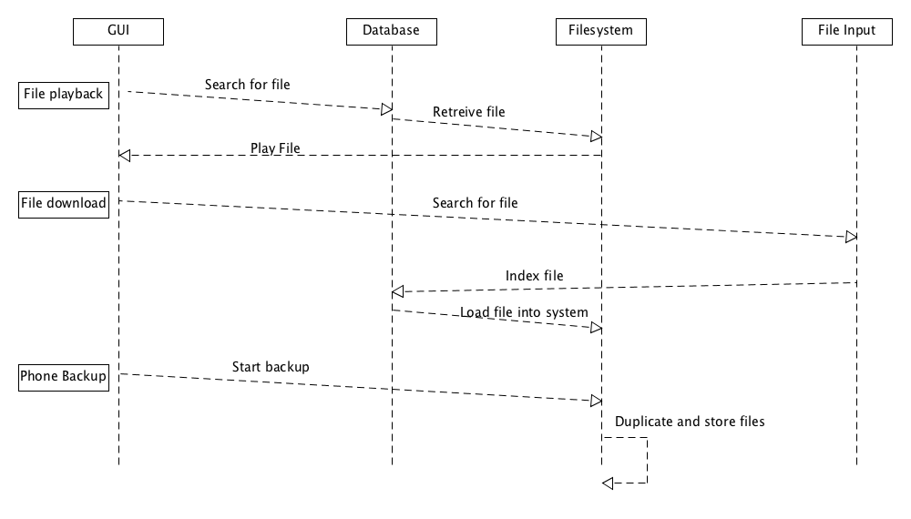
Sequence Diagram

Slide 5
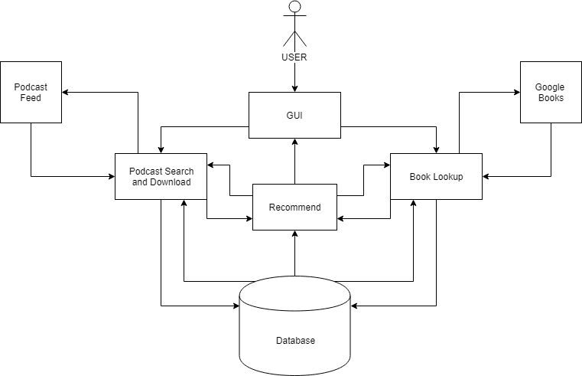
Data Flow

Slide 6
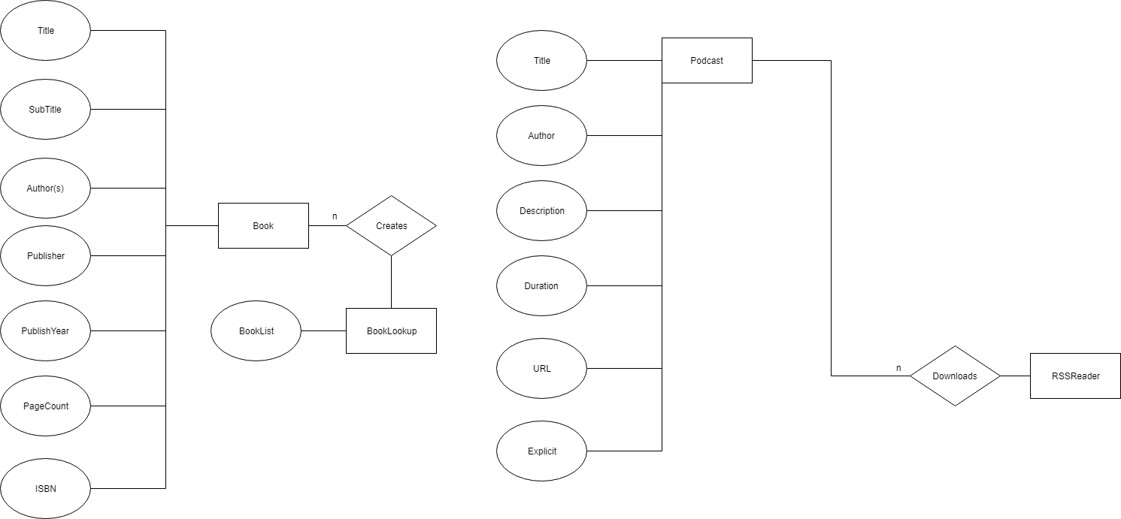
ER Model
Needs updating due to formatting and program issues

Slide 7




Gui Systems
JavaFX through Netbeans
FXML with Gluon Scene builder
Icons with Affinity Designer and Pixelmator

Slide 8


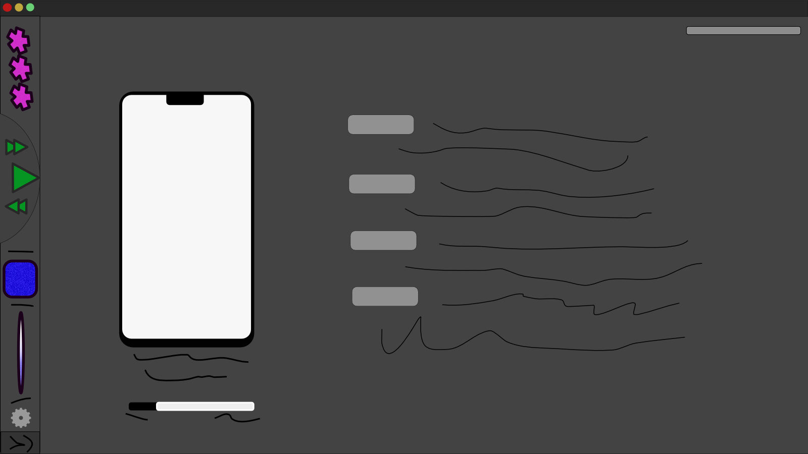
GUI
Windows

Slide 9
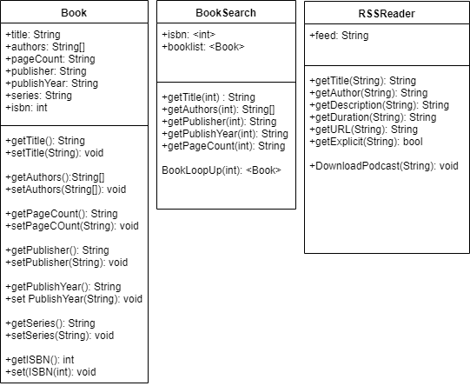
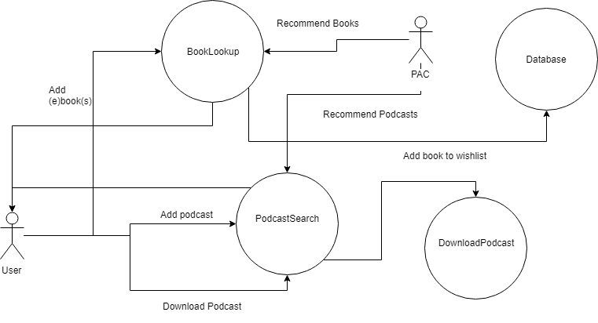
Data and Information Input
Book Search - JSON Library
Podcast Search - Java Rome Library with support from JDOM Library

Slide 10
Data and Information Input Analysis
Book Search
Complexity of O(n)
Dependent on internet speed
The time is directly link to the number of books being searched for
Podcast Search and Download
Complexity of O(n)
Dependent of internet speed
Download is dependent on:
Number to be downloaded
Size of each file
Recommendation
Complexity may require more research
Depends on internet speed
Depends on current amount of data in the database

Slide 11
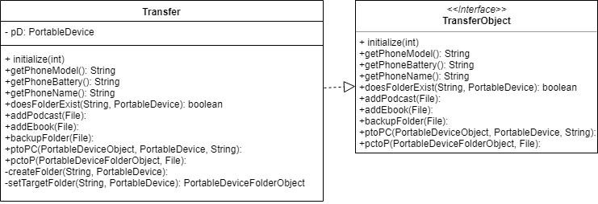
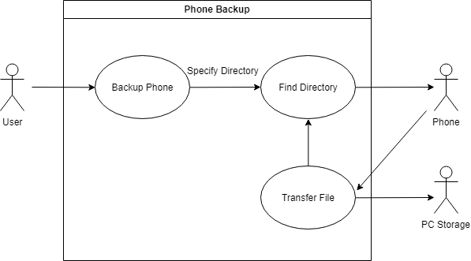
Data Transfer
Phone Backup - java with jMTPe library

Slide 12
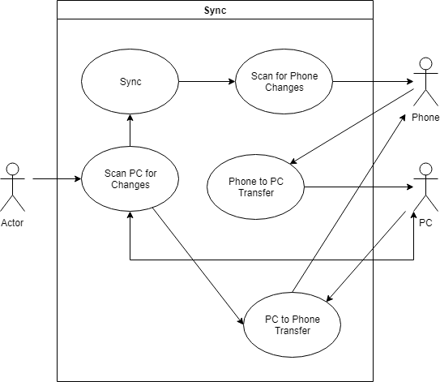
Data Transfer Continued
Sync Phone and PC - Java with jMTPe library

Slide 13
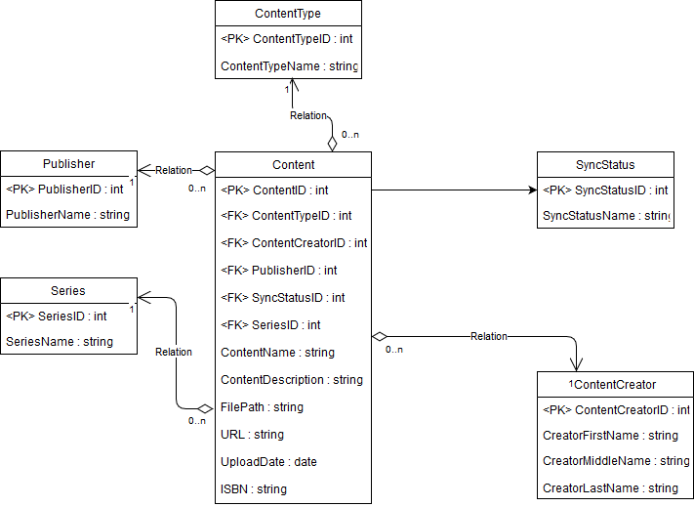
Database
We are utilizing SQL Server Express to embed the database into the application.
Database holds information about the content stored like author, type, publication date, etc.

